Slide 1
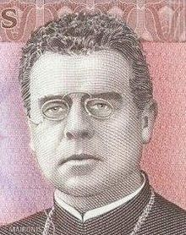
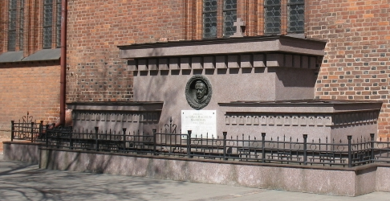
Jonas Mačiulis MAIRONIS
Lithuania’s National Poet
By Daiva Miller, Adult Class Teacher
Indianapolis Lithuanian School
Notes:
Today we will learn a bit about Lithuania’s most beloved poet. His photo is on the bottom left of this slide.
Does his image tell you anything about him? ……….
Priestly collar??; old-fashioned glasses??; Serious demeanor??; …
he was born in 1862—150 years ago!!!
And he died in ---1932—at the age of 70 when Lithuania was really coming into its own as an independent westernized country in the heart of Europe, and an exporter of agricultural products.
That is his tomb on the bottom right. He was buried at Kaunas Cathedral with great love and respect and a monument to his poetry and to him stands there still.

Slide 2
Raseiniai is just west of the center of Lithuania.
He was born in the region of Raseiniai in October or November 1862
to
Aleksandras
and Ona
Mačiulis
He died June 28, 1932.
Notes:
Jonas was born November 2, 1862 (Although using the old Russian calendar, the date was in late October.
Raseiniai is a beautiful rural area just west of the center of Lithuania. It is northwest of Kaunas which is in turn northwest of today’s capital, Vilnius.
The village of Bernotai, nearby was the place he spent his early childhood. It was a lovely place, with the Sandrava a winding little river running through it until it met the Lukne river which emptied into the larger wider Dubysa River.
As you can see on the slide, his parents were Aleksandras and Ona Maciulis.
Aleksandras was an intelligent, talented, and prosperous farmer who was a leader in his community. Everyone sought out his opinions and listened to his counsel. Some say he was not able to read, but he valued education and made sure his children attended schools and learned at home as well.

Slide 3
Raseiniai
Summer landscape
Notes:
It was in the Raseiniai area around Bernotai that the young boy came to love the beauty of wild meadows covered with coarse grasses and shrubs. He loved the little hills, the blue sky dappled with clouds, the cold rippling water of the streams and rivers, the majestic trees, and multicolored wildflowers. He often returned to those spots in his later years for inspiration and relaxation.

Slide 4
Raseiniai landscape
Notes:
Jonelis sometimes thought the countryside near his home was so beautiful it couldn't be real. It was a dream, he wrote. But the dream was real. His favorite seasons were spring and summer, and his poems are full of the descriptions of budding flowers and trees, green plants of all kinds, singing birds and fragrant fields and flowers. He also loved the water and often wrote about bathing in it, sailing on it, and about what is hidden beneath it.
Rivers with lush green tree-shaded banks and wild meadows covered with coarse grasses and shrubs was the landscape Jonas came to know well, and he often returned there in his later years for inspiration and relaxation.
It was here that the young boy came to love the beauty of nature. He loved the little hills, the blue sky dappled with clouds, the cold rippling water of the streams and rivers, the majestic trees, and multicolored wildflowers.

Slide 5
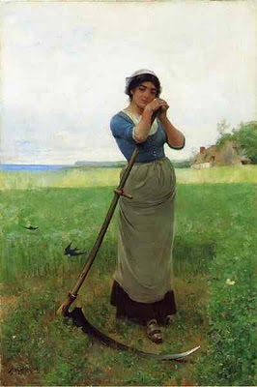
Using a scythe
Notes:
His father, as I have mentioned was a prosperous farmer, a hard worker who farmed not only his own land but also oversaw some farms for other landowners who needed experienced overseers. The Maciulis children learned about farming early and helped with regular chores even as tiny children. The little girls Pranciška, Kotryna, and Marcele would put on sandals and cut the spring crops with little scythes along with big brother Jonas.
Their father loved their beautiful homeland and taught his children that everything Lithuanian was sacred.
This sounds simple, right?
But no. ..life was complicated in Lithuania at that time.

Slide 6
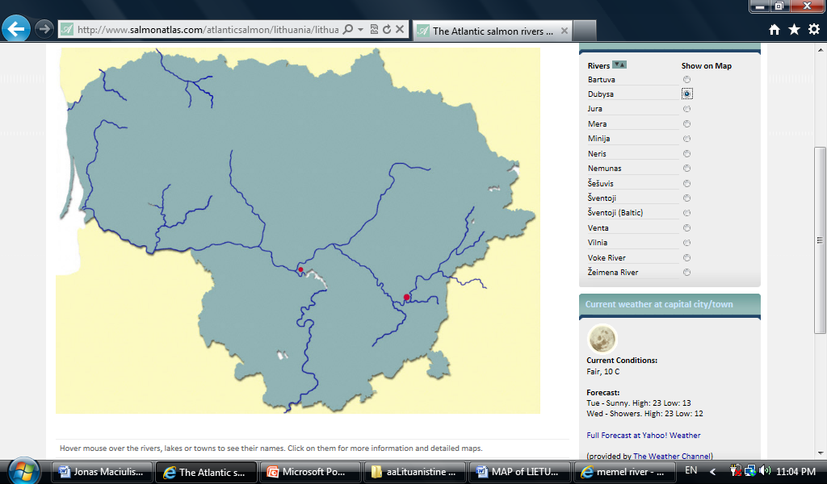
Ruled by Tsarist Russia as
* Klaipeda/Memel
German territory, called Memelland
*Kaunas
*Vilnius
Notes:
You may remember that Lithuania was a very large and powerful country in the 1500s,
But by the 1700's it had shrunk to about its present size and its name nearly disappeared because it had been been overrun by other powers, so in those early days of Little Jonas' life, Lithuania was not a free country.
Most of it was ruled by Russia, and about a fourth of it, the portion closest to the Baltic sea was ruled by Germany.
A year after Jonas Maciulis was born, there was an uprising or revolt by Polish young men who were anglry about being drafted into the Russian army. The revolt spread to Lithuania , Belarus, and ukraine. It became known as the January Uprising. Of course the Russian army was powerful and managed to put it down. The revolutionaries were killed, their families and others suspected of helping were deported to Siberia, and in the case of Lithiuania, our Lithuanian writing was banned as a punishment in hopes that the language would die out. When the language was used in written form, people had to use Cyrillic letters ..the kind greeks and russians use.
Ruled by Germany
Ruled by Russia
Vilnius
Kaunas
.Klaipeda

Slide 7
Мачюлис
Индиана
Литва
Америка
Notes:
If someone wanted to write something in Lithuanian, they had to use Cyrillic letters ..the kind Greeks and Russians use. Can you read them? The top one says Maironis , the big one on the left says Indiana, then Lietuva, (well—Litva, actually) and America.

Slide 8
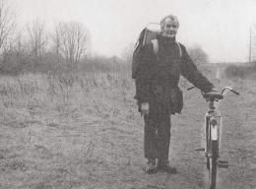
Notes:
Schools were already operated in Russian—not Lithuanian, for the most part, but even Lithuanian language classes in the schools were suspended in most locales because Lithuanian writing in any form except that using the Cyrillic letters of the Russian language became against the law!!!
Luckily, there were people willing to risk their lives for the sake of their language and culture. They knew that without a language, a culture disappears, and with the culture, so does the history.
They smuggled books in backpacks, and saddlebags. These were the knygnesiai—bookbearers.

Slide 9
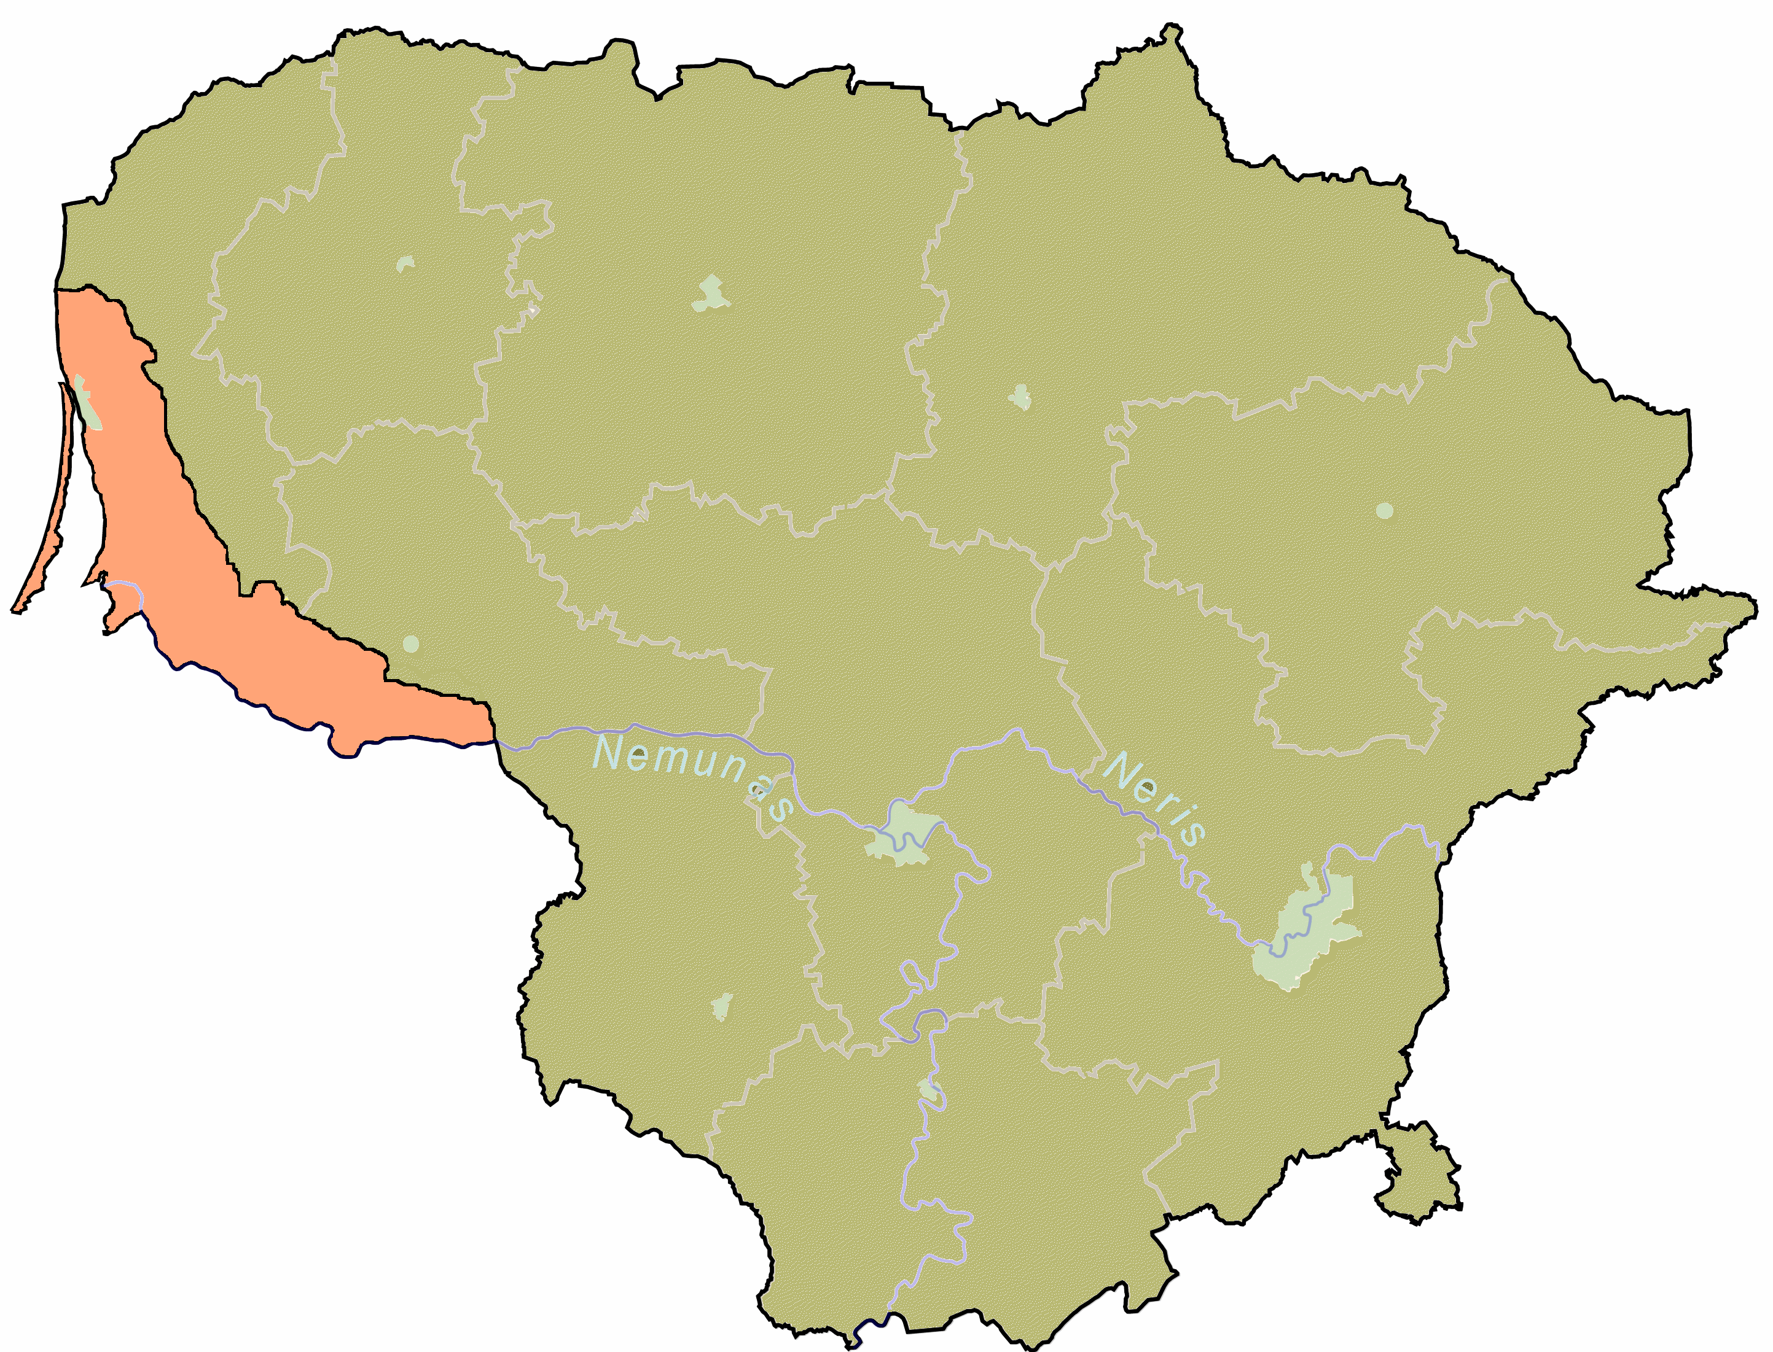
Notes:
They brought books and newspapers and magazines in from Prussia (Germany) where there were many Lithuanian speakers. Remember that part of today’s Lithuania on the map that was ruled by Germany??? That’s where they printed that stuff.
In some ways we owe our own appreciation of Lithuanian culture to these brave men and women. And certainly Independent Lithuania would not have emerged in the 19th century if they had not been such heroes.

Slide 10
Mothers taught their children to read Lithuanian while working at the spinning wheel or doing other indoor jobs.
Notes:
Of course having books was not enough. Since they were illegal;, they had to be hidden and only used secretly when no one was watching.
So
Mothers and grandmothers --those who worked indoors secretly taught children to read and write and to LOVE their precious Lithuanian language.
Don’t we always like best the things that are forbidden? Anyway, but the time he was 11, it was time for high school

Slide 11
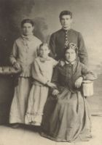
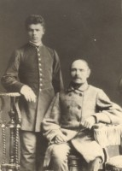
Notes:
Anyway, by the time he was 10 he finished elementary school so Jonas was sent to Kauno gimnazija, a high school at age 11. Jonas is about 13 or 14 in these photos –one with his dad and one with his mother and two sisters.

Slide 12
Kauno Maironio gimnazija
His parents sent him to Kaunas for High school at age 11!
Notes:
This was a Russian school at that time, meaning most of the classes were conducted in Russian. There were no Lithuanian schools, remember?
When he graduated from HS, he enrolled in the university in Kiev—now part of Ukraine, but he didn’t like the classes and decided to do what his parents wanted him to do in the first place—enroll in a seminary program

Slide 13
Beautiful Kaunas. Seminary grounds are on the left near the statehouse or Rotue
Notes:
Even there, the classes were not in Lithuanian for the most part. In fact most of them were in POLISH as that was the traditional language of the nobility. The priest seminary marked the beginning of the creative road for Jonas Maciulis. He plunged into the Lithuanian Romantic literature in Lithuanian and Polish languages – he read the poetry of Antanas Baranauskas, Adam Mickiewicz, Władysław Syrokomla, Juliusz Slowacki, the works on Lithuanian history by Simonas Daukantas, Teodor Narbutas, Józef Ignacy Kraszewski. These texts shaped the historical consciousness of the budding poet and nurtured his Lithuanian patriotism.
While at the seminary, Jonas destroyed all his early poetry written in Polish and resolved to write in Lithuanian. He was soon known as a poet among fellow students; they passed around his handwritten poems., and even set some to music. The early unpublished poems have not survived. The only known fact is Jonas' debut in the underground Lithuanian newspaper Auszra, (the dawn) where his poem Sorrow of Lithuania was printed in 1885 under the pen name of Zvalionis. Can you guess why he used a different name?
During his Kaunas years, the young writer also composed his first two works of larger scope: a short history of Lithuania Stories about the Lithuanian Past (published in 1891) and a poem Lithuania – a description of a poetic journey across the land of Lithuania dedicated to Antanas Baranauskas.
Stories about the Lithuanian Past was later used as the first textbook of Lithuanian history for two decades due to its popular presentation of a chronological history of the Lithuanian nation, the history of its statehood and culture from prehistoric times to the present. Maironis did not publish the poem Lithuania but he expanded the topics and ideas in it in later works.

Slide 14
St. Petersburg
This beautiful Russian city is often called the Venice of the north.
The poet spent 15 years teaching here.
Notes:
After four years, he was sent to St Petersburg Theological academy in Russia where he finished his theological studies and earned a masters degree and a doctor’s degree in theology. He then became a professor of moral theology and taught there for 15 years! While in Russia, he wrote many many poems in Lithuanian and published them using pseudonyms/pen names—just as he had earlier .

Slide 15
1909 Back home again in Kaunas
!
Notes:
While in Russia, he wrote many many poems in lithuanian and was able to publish them using pseudonyms—you know kind of like Mark Twain. His best name was Maironis, and he became so well known by that name that when he came back to Kaunas to become rector of the seminary there, his students called him professor Maironis or Father Maironis.

Slide 16
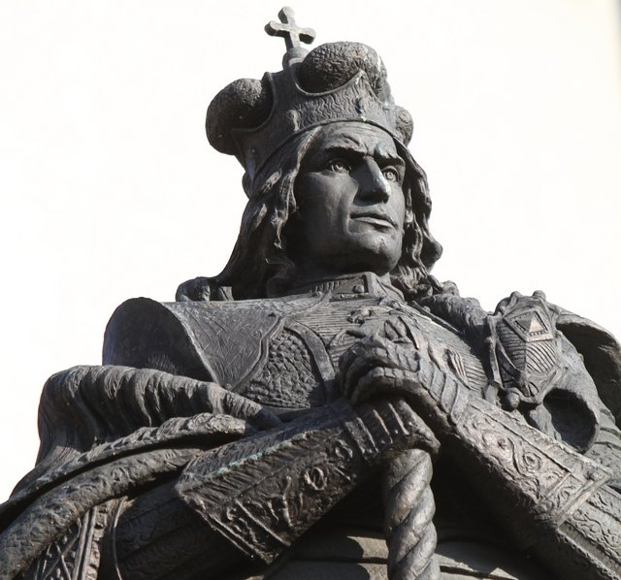
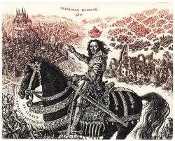
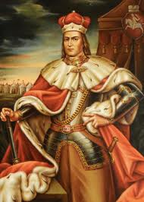
Notes:
While he is mostly loved for his romantic descriptions of Lithuania’s beautiful landscapes, he also wrote about history and myth. He wrote about decency and honor, and about sorrow.
His critics say he romanticized everything, but Lithuania needed romanticizing in those days. He is recognized by many as one of the leading figures in the renaissance or rebirth of Lithuania which led to its independence after World War one.
Lithuanians needed to see themselves a capable of ruling themselves—worthy of the responsibility and courageopus in the face of adversity before the nation could rise up and demand its freedom.
So Maironis wrote not only poems but plays too. He wrote plays about the early leaders in Lithuania: Vytautas and the Teutonic Knights, the Death of Kestutis, and Vytautas the Great King. He also wrote a few history books!
But he is best loved and remembered for his poems. Many of them have been set to music and are achingly beautiful. I played one at the beginning of class. Do you remember it?

Slide 17
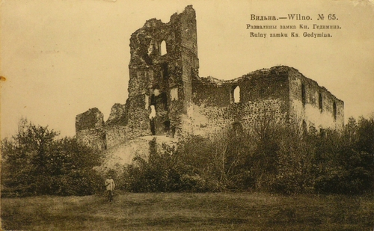
Notes:
TRAKAI CASTLE Maironis
With lichen and mould overgrown all around
A time-honoured castle there looms!
Its true high-born rulers now sleep below ground,
Yet Trakai outlasted their tombs.
While centuries run, its grim ruins grow older,
Deserted and lonely, they gradually moulder.

Slide 18
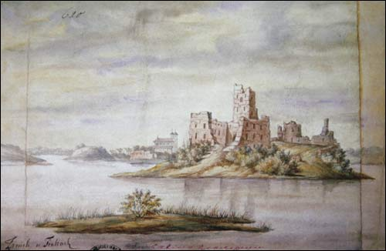
Notes:
When over the castle the wind bursts to moan
The lake lying round climbs its walls:
A wave rides a wave, and a mouldering stone
Works loose and submissively falls.
The towers keep crumbling and day after day
So many a heart fill with gloom and dismay.
Old castle! Long centuries echoed your name!
Great men rose to glory with you!
You saw the Great Vytautas' power and fame,
His regiments on a review.
Where is now your might that was dazzling with glory?
Where is your antiquity lauded in story?

Slide 19
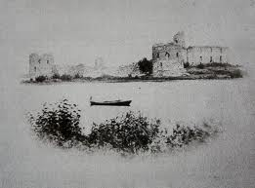
Notes:
You walls, dark and ruinous, covered with grime,
Defenceless, unpeopled and dumb!
I tenderly fancy your most precious time
You've had in the centuries' run!
Invaluable time! Shall we see your revival?
Or shall you like youth just in dreams find survival?
Each time when through Trakai I happen to go
With pain my heart bitterly cries.
A sorrowful tear down my cheek starts to flow
And suddenly clouds my blue eyes.
In vain my poor heart tries to seek consolation,
All round I see darkness and bleak desolation.
Translated by Lionginas Pažūsis

Slide 20
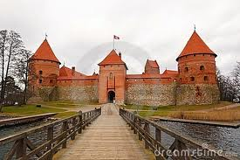

Slide 21
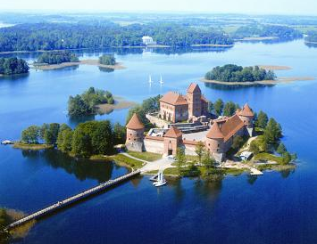
Notes:
And I will end the power point here, but I’d like to tell you one more poem as it is a lovely myth about amber that has been made into a children’s book. It is called Jurate and Kastytis.

